Slide 1
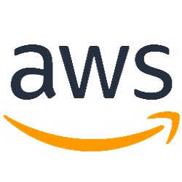
Amazon virtual private cloud (VPC) Topic: 3 Create by: MaiLT - Team 1 Date: 22/5/2019

Slide 2
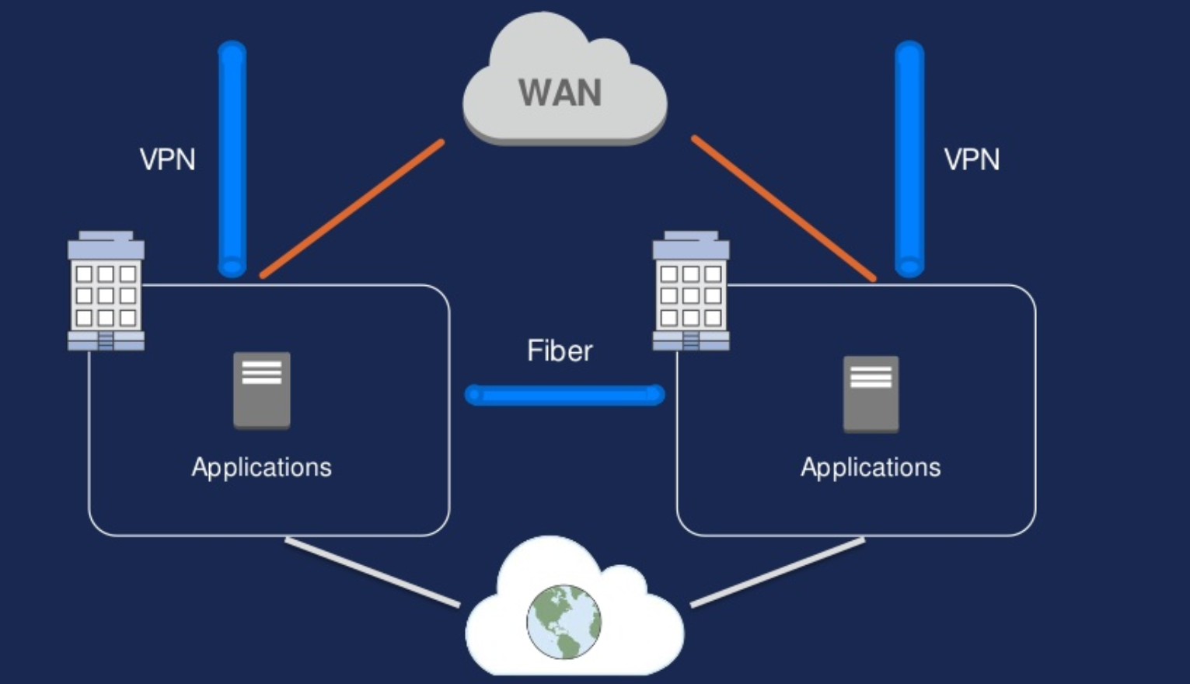
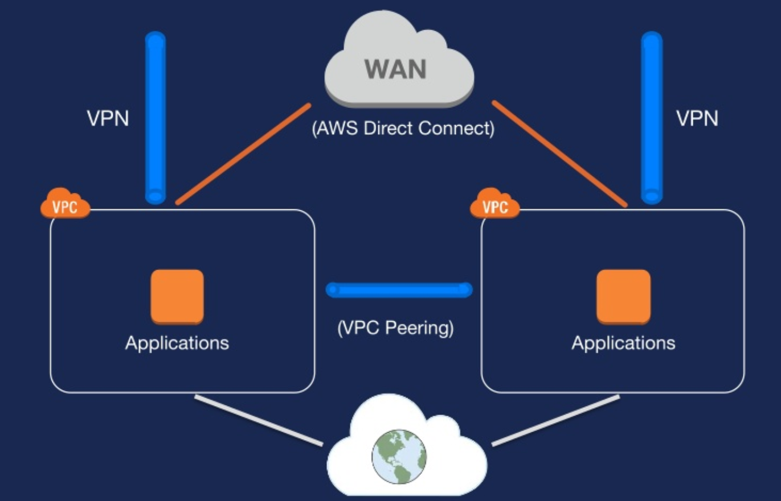
INTRODUCTION
Traditional network
AWS network

Slide 3
This topic will cover to:
Fundamentals:
VPC Overview
Picking you IP space
Subnet design
Routing and NATing
VPC Security
Advanced topic:
VPC Peering
VPC Flow Logging
VPC Endpoints
DC Connectivity:
IPsec VPN Tunnel
AWS Direct Connect

Slide 4
AWS VPC Overview

Slide 5

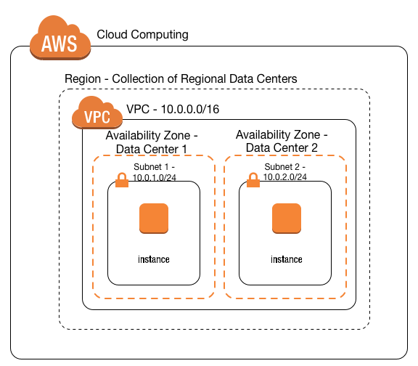
What is an Amazon Virtual private cloud (VPC)?
“A virtual network that closely resembles a traditional network that you’d operate in your own data center”

Slide 6
What’s in the VPC tool box?
VPC: User defined address space up to /16 (65,536 addresses)
Subnets: 200 user-defined subnets to /16
Route Tables: Define how traffic should be routed from/to each subnet
Access Control Lists: Stateless network filtering between subnets.
Internet Gateway: A logical device enabling traffic to be route to/from the public internet.
Managed NAT: Provide Network Address Translation to private instances for 10Gbps traffic.
Virtual Private Gateway: the Amazon end of a VPN connection.
Customer Gateway: The router at the customer end of a VPN connection.

Slide 7
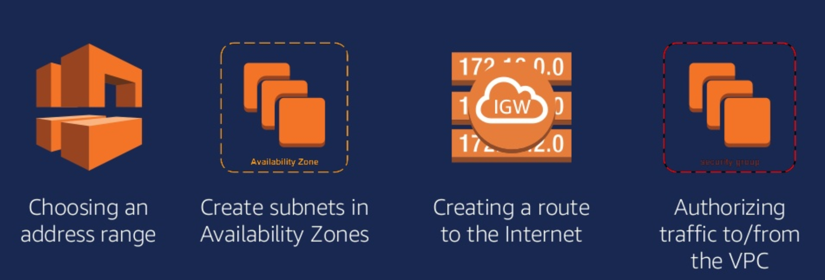
How to create an Internet-connected VPC step?

Slide 8
Picking for IP Space

Slide 9
CIDR notation review
CIDR range example:
172.31.0.0/16
1010 1100 0001 1111 0000 0000 0000 0000

Slide 10
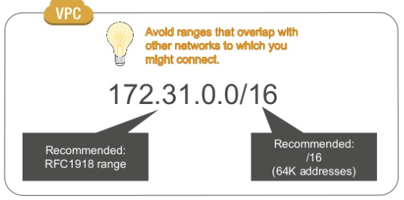
Choosing an IPv4 address range for your VPC

Slide 11
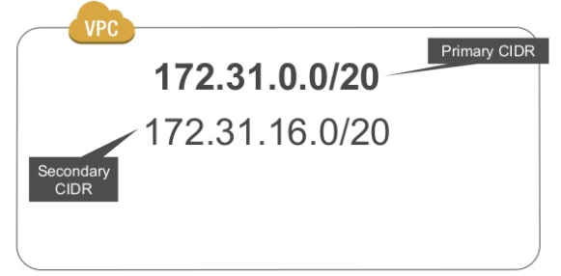
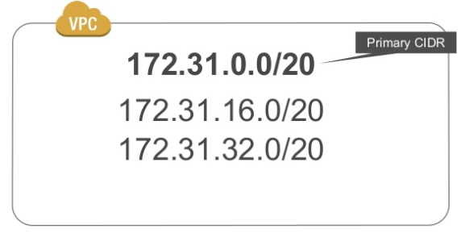
Adding a secondary IPv4 address range

Slide 12
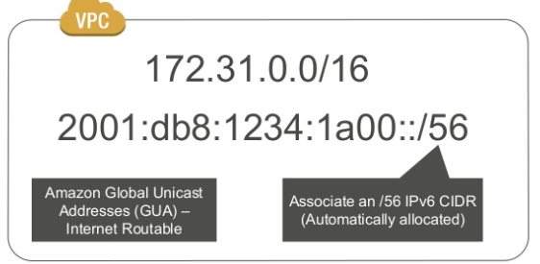
IPv6 in Amazon VPC-Dual-stack

Slide 13
Subnet

Slide 14

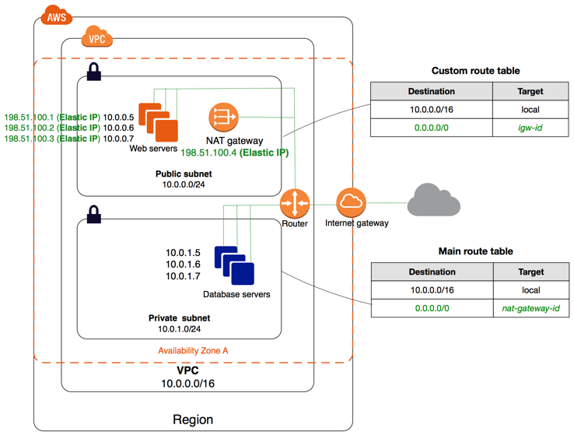
Public/Private Subnet

Slide 15
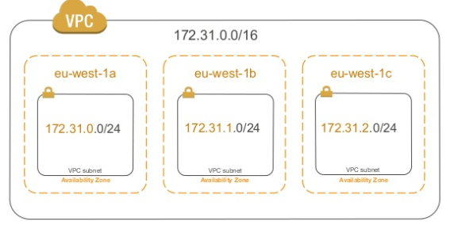
VPC subnets and Availability Zones

Slide 16
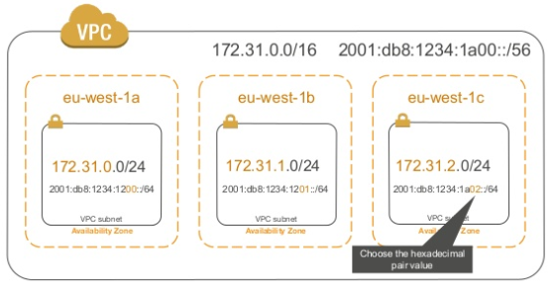
VPC subnets and Availability Zones– IPv6

Slide 17
VPC subnet recommendations
/16 VPC (64K IPv4 addresses)
/24 subnets (251 IPv4 addresses)
One subnet per Availability Zone
For IPv6:
/56 Allocated per VPC (Lots of addresses)
/64 subnets (256 Subnets)

Slide 18
Route to the Internet

Slide 19
Routing in your VPC
Route table contain rules for which packets go where
Your VPC has a default (main) route table
You can assign different other tables to different subnets

Slide 20
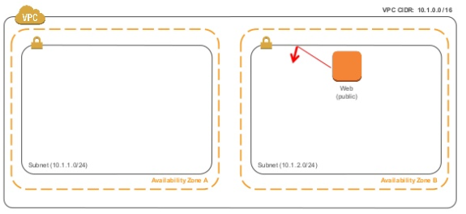
Public subnet routing

Slide 21
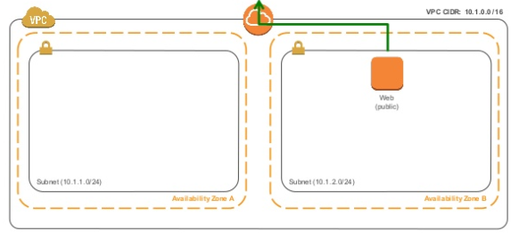
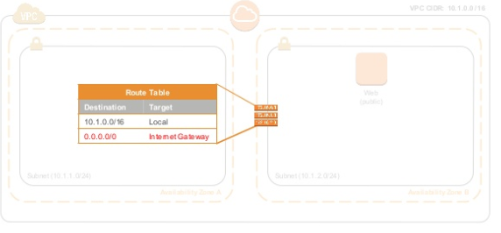
Public subnet routing-Internet Gateway

Slide 22
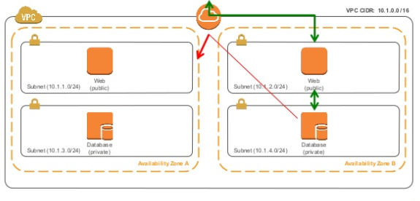
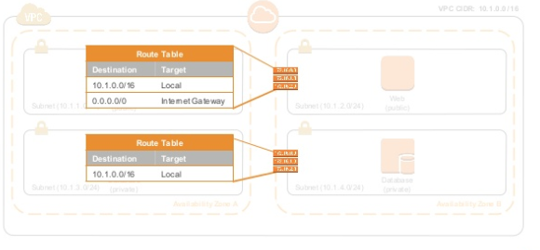
Private subnet routing

Slide 23
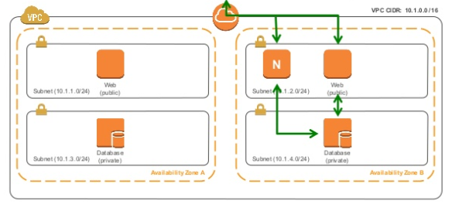
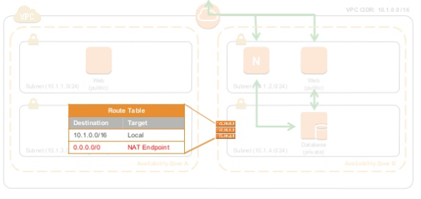
Private subnet routing-NAT gateway

Slide 24

Demo

Slide 25
Authorizing Traffic: Networks ACLs and Security Groups

Slide 26
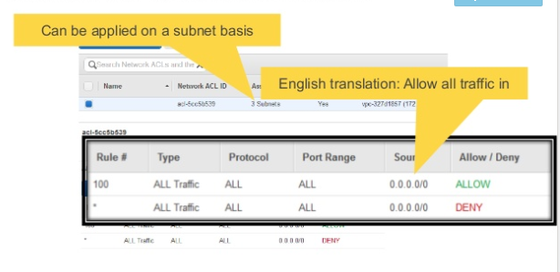
Network ACLs: Stateless firewalls

Slide 27
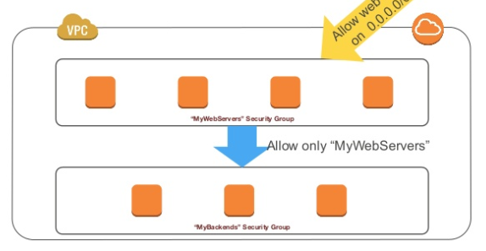
Security groups follow application structure

Slide 28
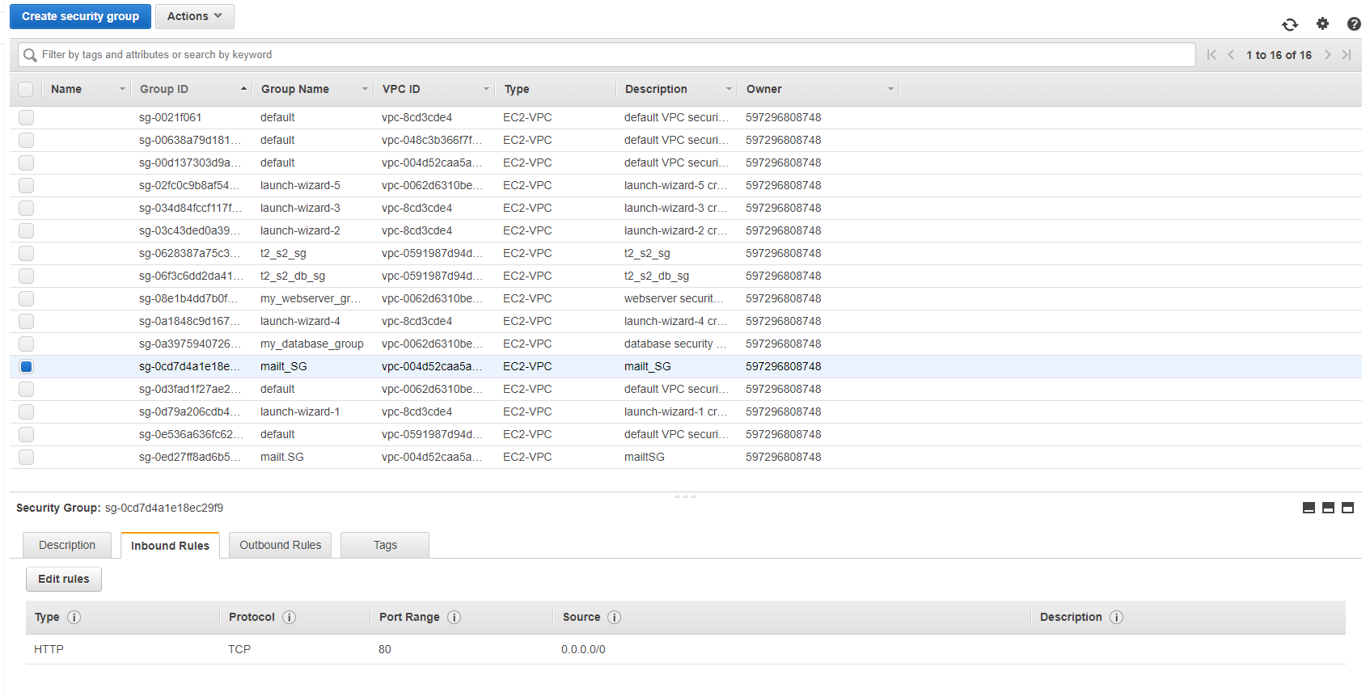
Security groups example: Web servers

Slide 29
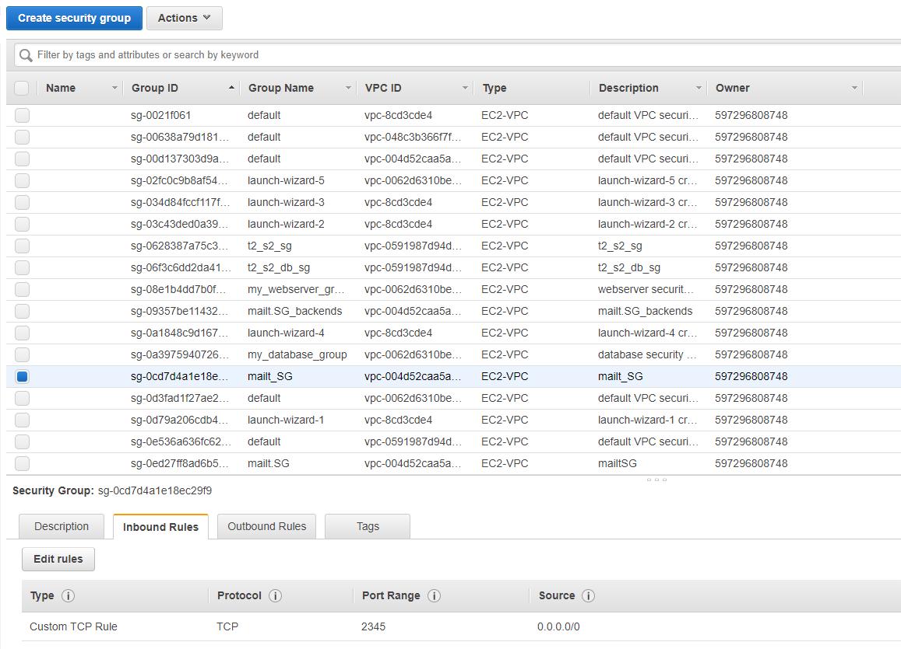
Security groups example: Backends

Slide 30
Security group in VPC: additional notes
Follow the Principle of Least Privilege
VPC allows creation of egress as well as ingress Security group rules.
Many application architectures lend themselves to a 1:1 relationship between security group (who can reach me) and IAM roles (what I can do).

Slide 31
Routing by subnet

Slide 32
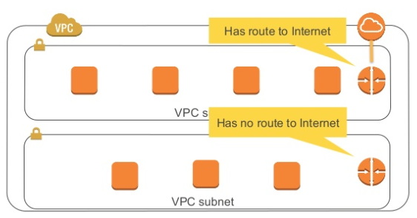
Routing by subnet

Slide 33
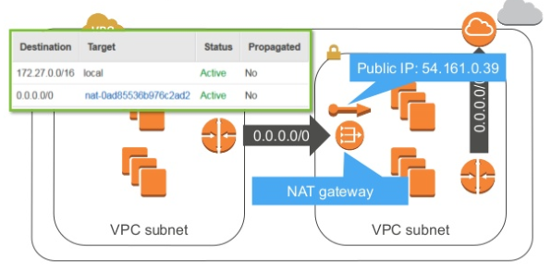
Outbound-only Internet access: NAT getway

Slide 34
IPv6 GUAs
For IPv6, Amazon VPC instance receive Global Unicast Address (GUA), which are Internet routable.
GUAs directly assigned to instance; there is no 1:1 NAT in the case of Internet access.
Using GUAs does not mean losing security or privacy-to have Internet access, you also need to have proper route tables, security groups and gateways.

Slide 35
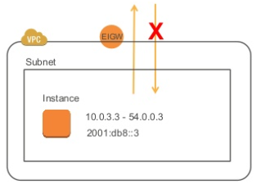
IPv6 Egress-only Internet Gateway
A new virtual device that provides egress-only Internet access over IPv6
No middle box to perform NAT, and no additional cost
No performance/availibility/connection limits

Slide 36
VPC Peering

Slide 37
VPC Flow Logs

Slide 38
VPC Endpoint

Slide 39
VPC Endpoint

Slide 40
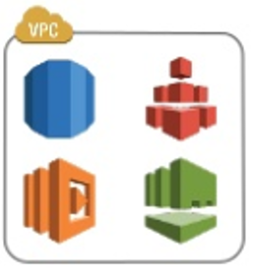
Place your screenshot here
Best practice for in VPC-AWS services.
Many AWS services support running in –VPC.
Use security groups for Least-Privilege network access.
For best avaibility, use multiple Avaibility Zones.
Ex:
Multi-zone RDS deployments
Use a zonal mount point for EFS access

Slide 41
THANKS!
Any questions?
Connect to github repository to read more detail: https://github.com/hueanmy/AWS-LEARNING

